Slide 1
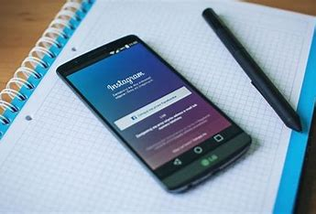
Instagram User Analytics
PRESENTER: KOMAL BARHATE

Slide 2

Agenda:
Project Description
Approach
Teach-Stack Used
Insights
Results

Slide 3
Project Description
Instagram user analytics:-
Using Instagram user’s data to find the insights that can be used in the business for launching a new marketing campaign, improving user experience, etc.
Some tasks given to me were:
A.)Marketing Analysis
Loyal User Reward
Inactive User Engagement
Contest Winner Declaration
Hashtag Research
Ad Campaign Launch
B.)Investors Metrics
Users Engagement
Bots And Fake Accounts
TITLE:
INSTAGRAM USER ANALYTICS

Slide 4

Approach & Tech-Stack Used
Approach: The database given was cautiously converted into MYSQL tables so that it can be easily understood by anyone. After arranging the data various task (queries) were given to obtain the desired output.
Tech-Stack Used: MySQL Workbench 8.0 CE -MySQL Shell -MySQL Command Line Client.

Slide 5
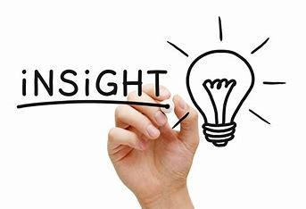
Insights
Insights gained include identifying loyal users, inactive users, contest winners, popular hashtags, and optimal ad campaign launch days.
Average user posts and potential bots were also analyzed.
These insights help make data-driven decisions for marketing and investor strategies on Instagram.

Slide 6
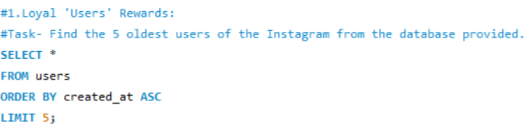
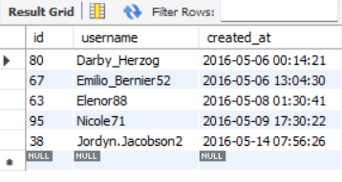
Result : Task-1 Loyal User Rewards
Queries:
Output:

Slide 7
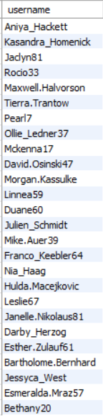

Task-2 Inactive User Engagement:
Queries:
Output:

Slide 8
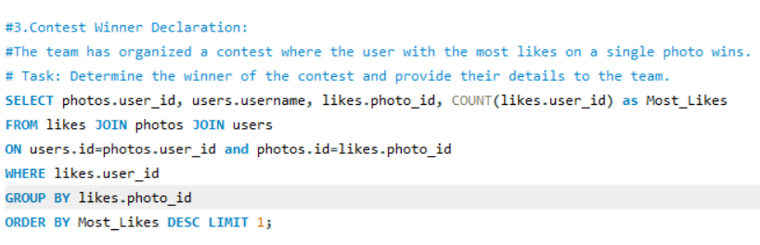

Task-3 Contest Winner Declaration:
Queries:
Output:

Slide 9
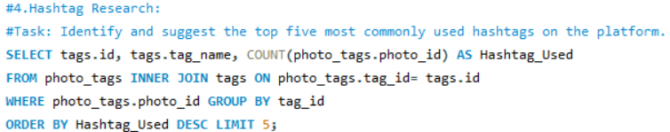
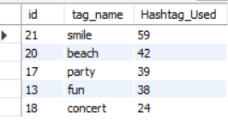
Task-4 Hashtag Research:
Queries:
Output:

Slide 10
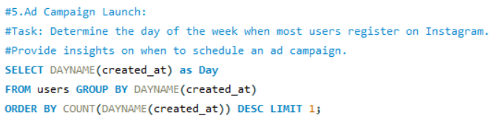

Task-5 Ad Campaign Launch:
Queries:
Output:

Slide 11

Task-6 User Engagement:
Queries:
Output:

Slide 12
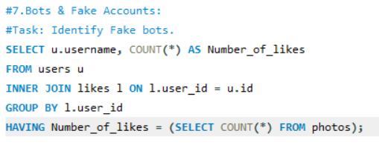
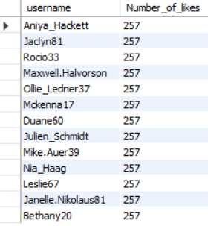
Task-7 Bots & Fake Accounts:
Queries:
Output:

Slide 13
Outcome
&
Link:
Link for MYSQL File:https://drive.google.com/file/d/1AHsmuFl0SHodXEMdiyWz4EB5HC0hIM0w/view?usp=drive_link
ONE: Insights
TWO: Impactful
THREE: Data-driven
FOUR: Valuable
FIVE: Beneficial

Slide 14




Thank You
LinkedIn (4) Komal Barhate | LinkedIn
Email komalbarhate2004@email.com
GitHub https://github.com/BarhateKomal

